Slide 1
DATA 601 – Lecture 01 Data Science Concepts and Workflows
UMBC Data 601
Instructor: Felix Gonzalez
fgonzale@umbc.edu

Slide 2
What is DATA SCIENCE?

Slide 3
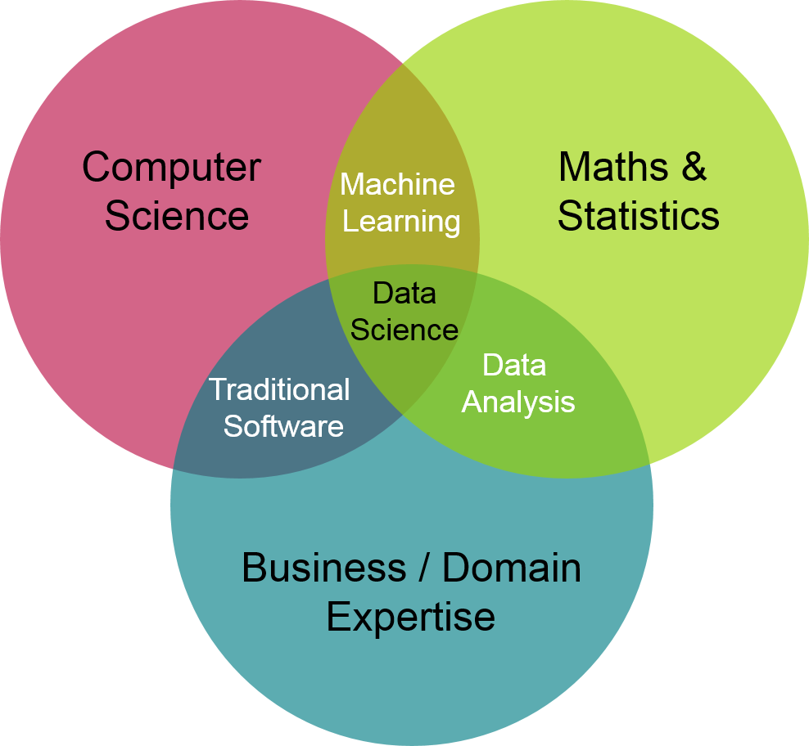
What is Data Science?

Slide 4
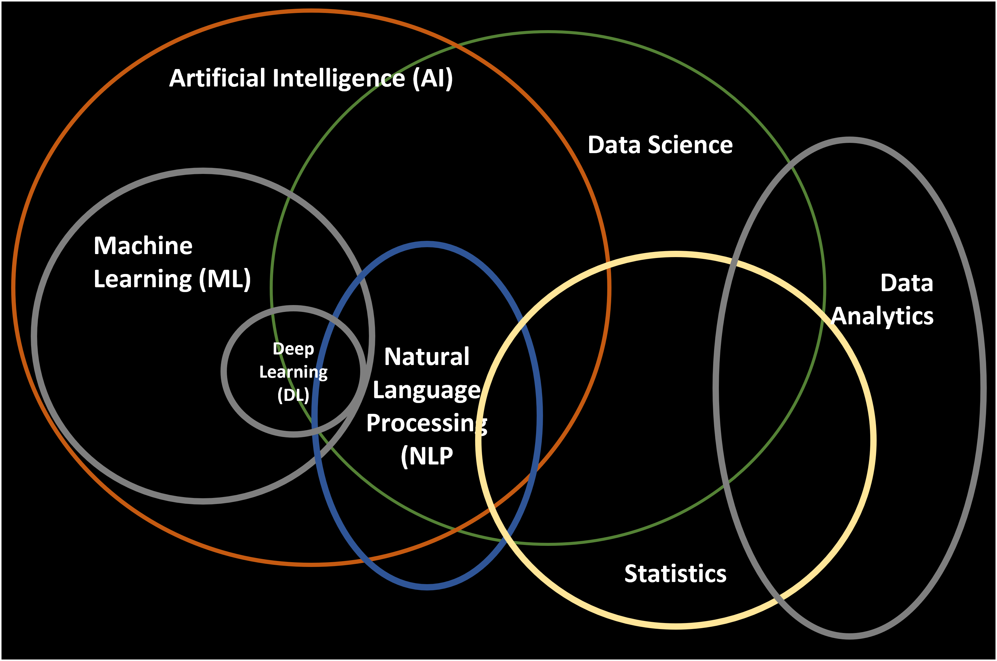
What is Data Science?

Slide 5
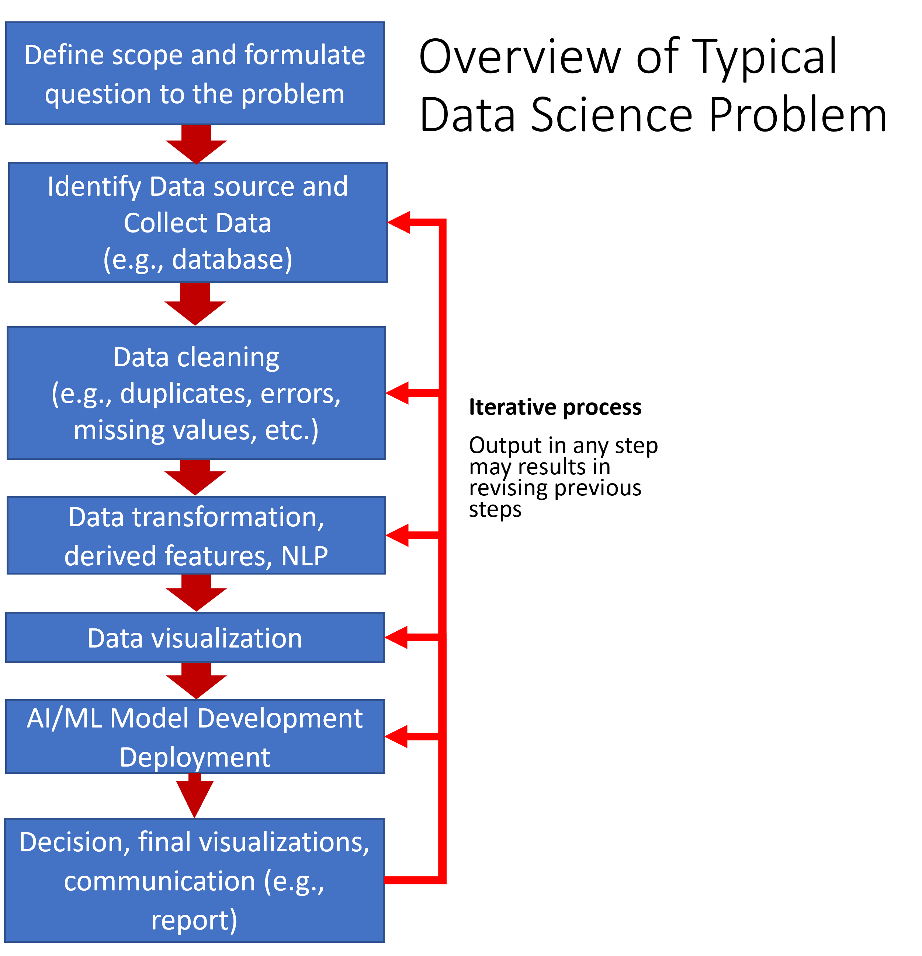
Data Science Process
Example Data Science Jargon:
Data cleaning
Data preparation
Data wrangling
Data transformation
Data augmentation
Data pipeline
Exploratory Data Analysis
AI and ML
Notes:
Many of the terms in this slide are often used interchangeably, their definitions can vary from various data analytic and data science commercial tools and frameworks and have various levels of overlap. We will talk about these during the class.

Slide 6
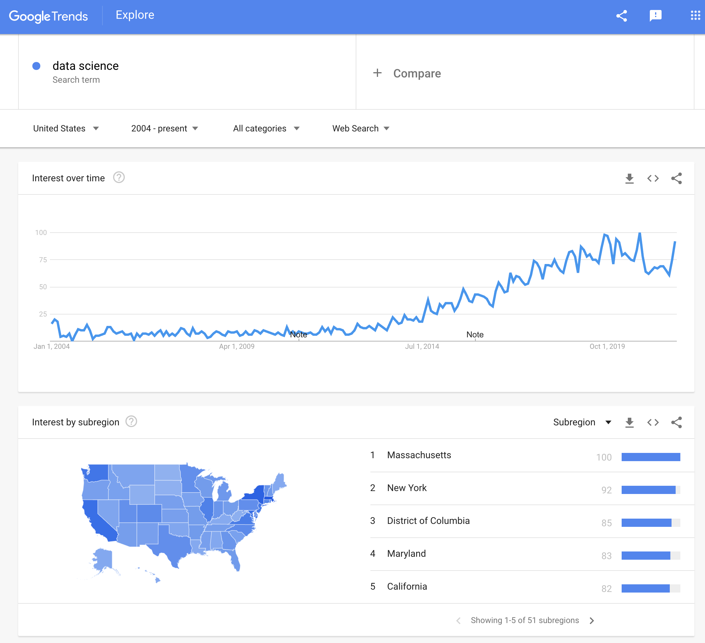
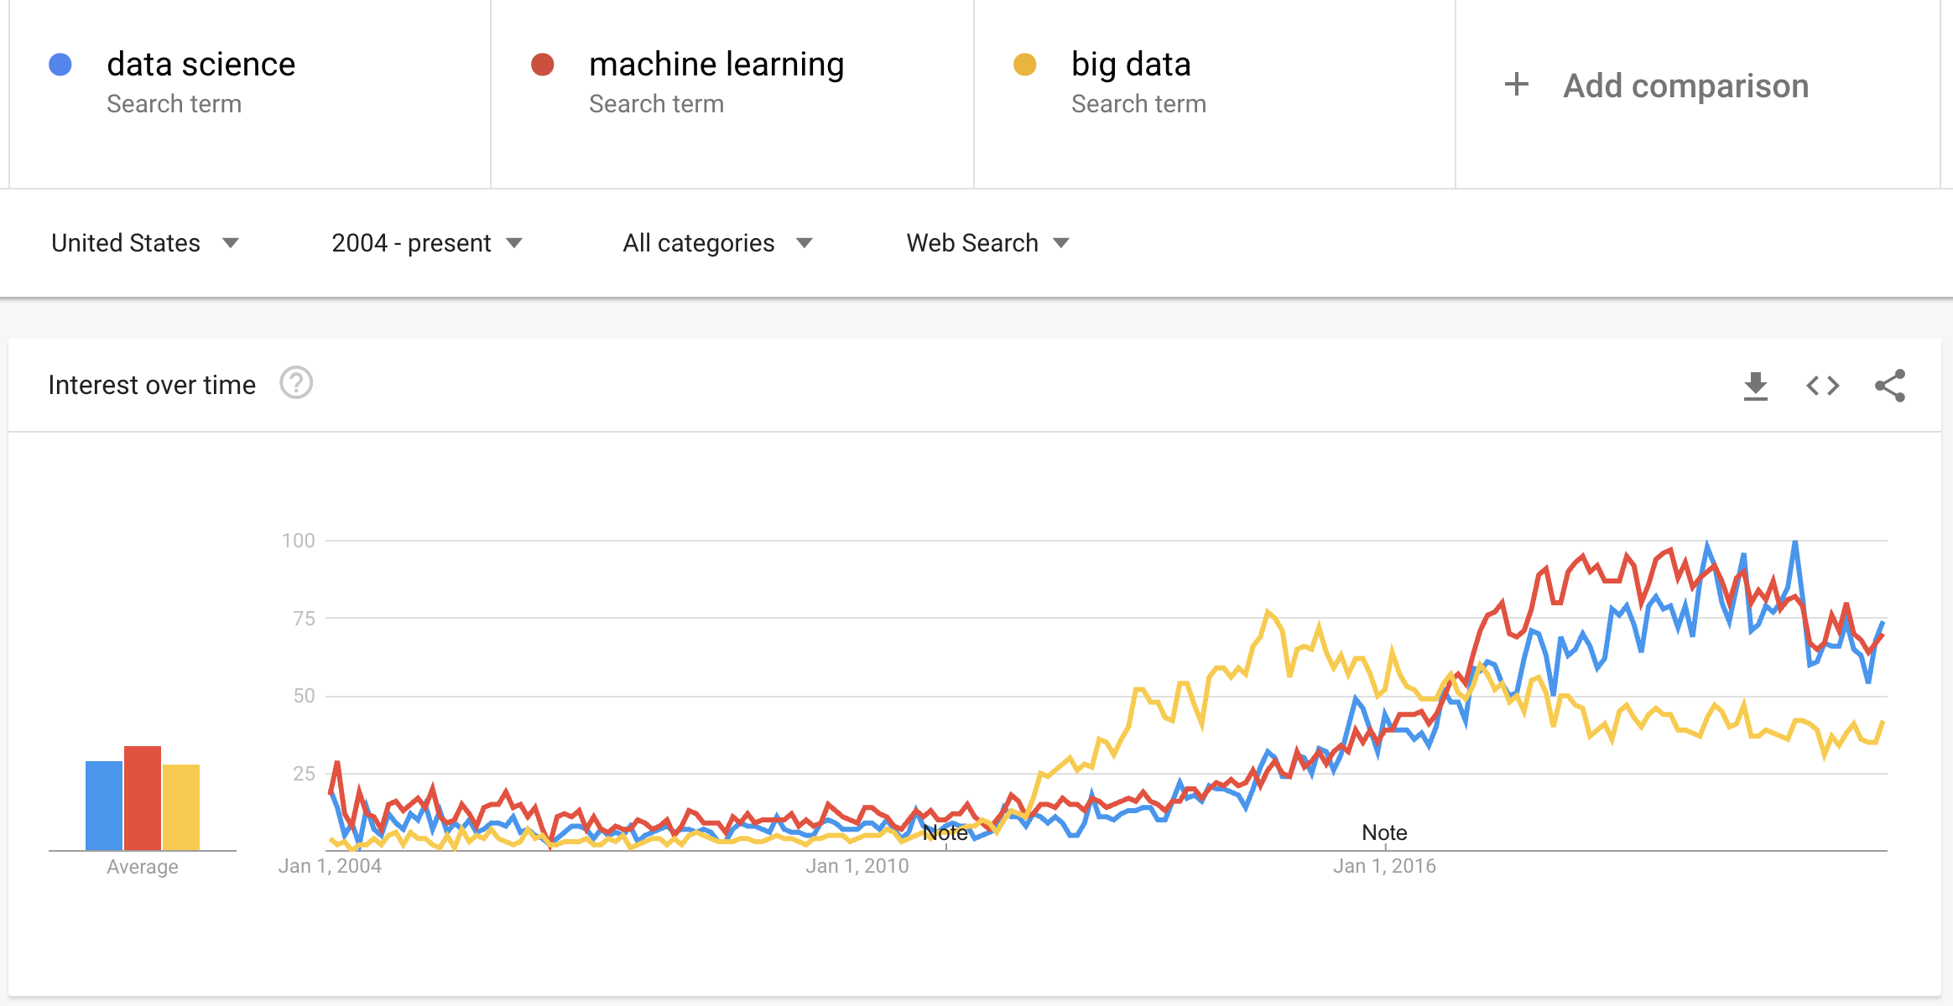
DS is an active field
Increasing interest in the DS field
There will always be something you haven't heard of before.
Know enough to be conversant with peers
Be curious about new topics
Research concepts and labels before using them
Lots of jargon.
Reference:
http://www.datascienceglossary.org/

Slide 7
The World of DS is Huge. Don’t get lost!

Slide 8
Lots of Tools and Platforms
Tools often have a combination of capabilities (e.g., visualization, AI, ML, NLP, etc.). Examples of readily available tools:
Open source (e.g., Python, R, Jupyter, JSD3, etc.)
Example of data analytics and data science platforms all with different capabilities, limitations, and learning curves:
Anaconda (Data science distribution package Python/R/Jupyter)
NVIDIA Deep Learning Institute (DLI)/Data Science Libraries (e.g., RAPIDS)/Omniverse
Google Cloud Services Platform
Amazon Web Services
MicroStrategy
MS Power Apps/Power Bi/Azure
Tableau
Hadoop
Palantir Foundry
SkySpark
PNNL Inspire (text analysis)
Low code or no-code development platforms
Jargon can vary from company to company from tools to tools.

Slide 9
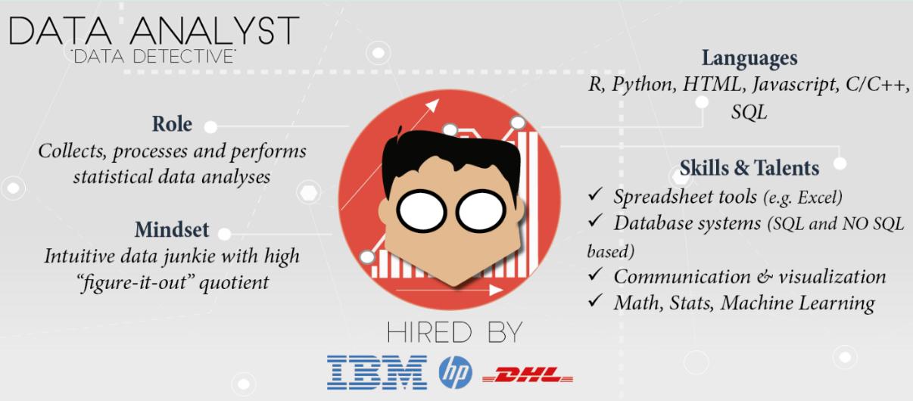
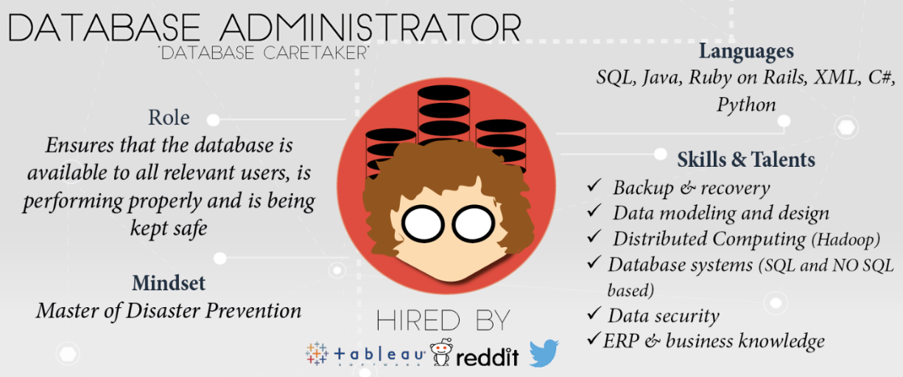
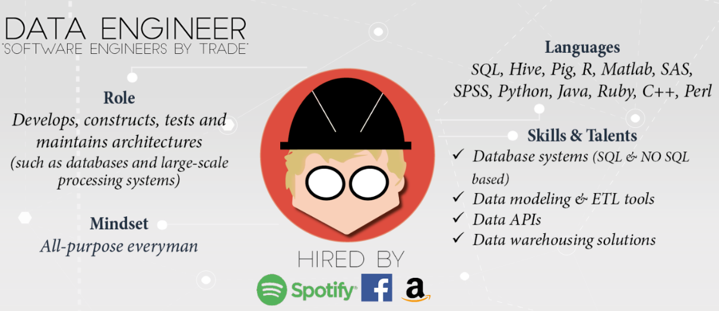
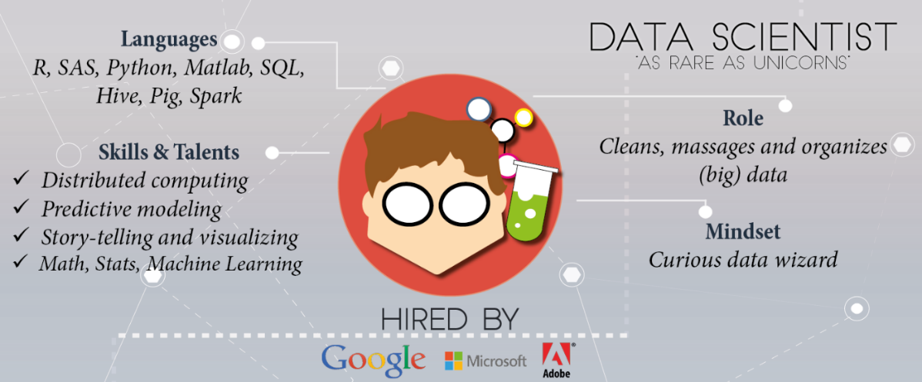
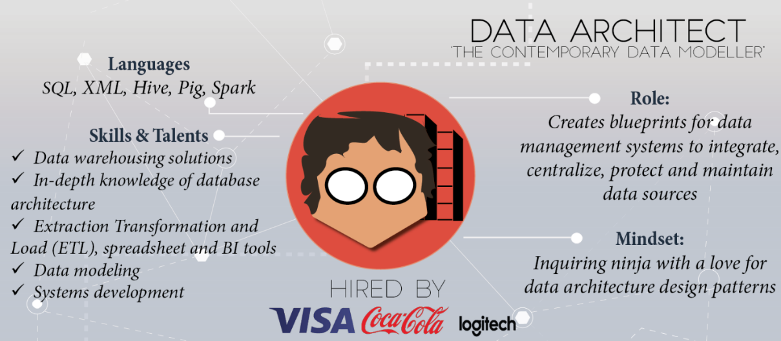
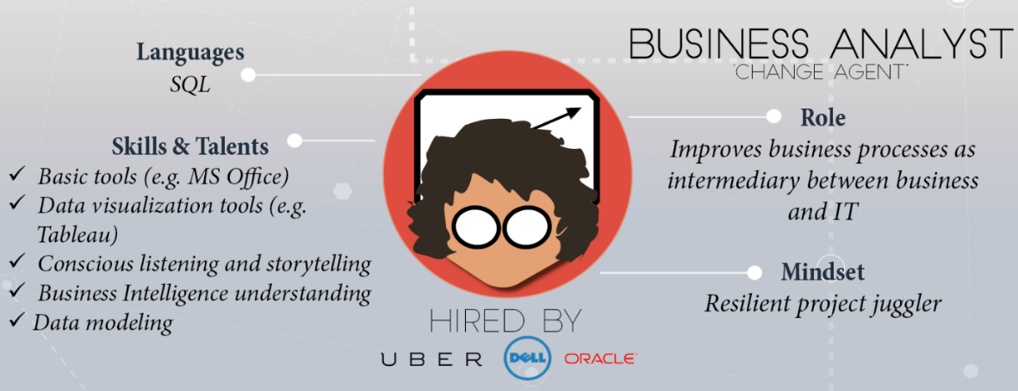
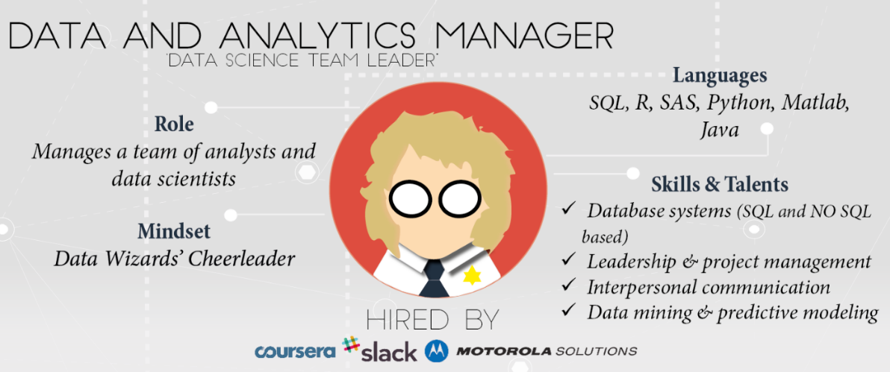
Skills and experience matter more than title and labels
https://www.datacamp.com/community/tutorials/data-science-industry-infographic
Historical progression: data grooming, data mining, data scientist

Slide 10
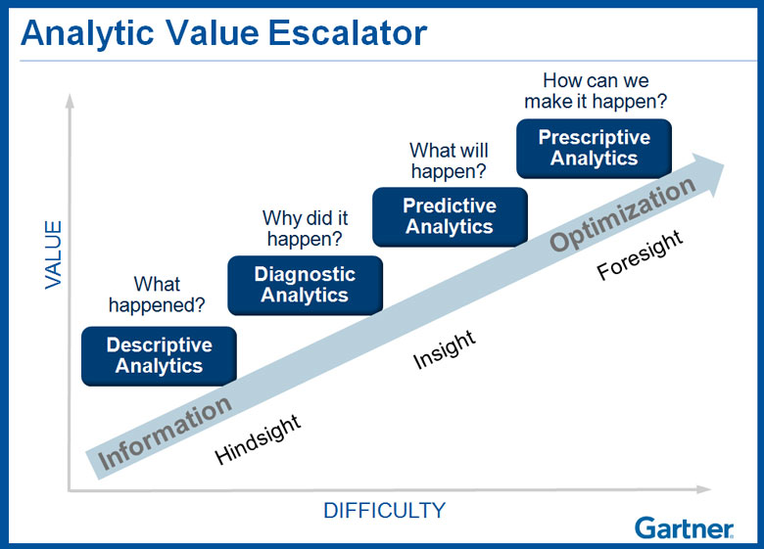
Why learn data science?
Explore: identify patterns​
Predict: make informed guesses​
Infer: quantify what you know
Motives:
Make money
Employment
Promotion
Help people
Gain new knowledge
Career opportunities

Slide 11
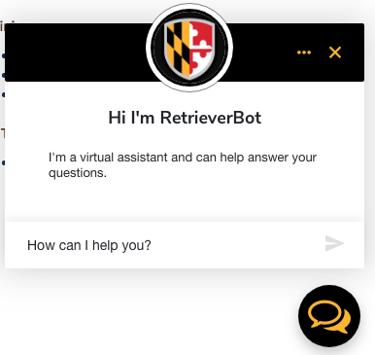
Large scale use cases with lots of data
Information Retrieval:
Google's search engine
Chatbots
Bank and Credit Card fraud detection
Logistics (DHL, UPS) of fleet management
Healthcare records from patients
Each depends on availability of compute and data
Notes:
https://www.thrillist.com/entertainment/nation/how-new-netflix-recommendation-algorithm-works#
https://medium.com/netflix-techblog/artwork-personalization-c589f074ad76
https://www.wired.co.uk/article/how-do-netflixs-algorithms-work-machine-learning-helps-to-predict-what-viewers-will-like

Slide 12
Assumption in this class
In class we will assume you are a lone data scientist on an island with an internet connection.
This is not the typical case - you'll have various stakeholders coworkers, customers, bosses, competitors, collaborators, peers.
Example of how class ≠ real world
This class will not use competitive grading. (Imagine if it were.)
As an employee at a company, you may be competing for a bonus or promotion
Consequence: personal and organizational politics factor into the work environment

Slide 13
Small scale use cases with not much data
As a business employee, bureaucrat or politician
How do I improve decision making process?
How do I evaluate the outcome of decisions?
How do I decrease the risk when faced with an opportunity?
How do I convince other stakeholders of the best course of action?
While not taking too much time, spending too much money, using the resources I already have access to, and in a way that is convincing?

Slide 14
Class Main Tools
Python with Jupyter Notebooks
Anaconda Data Science Platform (https://www.anaconda.com/)
GitHub (https://github.com/fgonzaleumbc/DATA601)
Blackboard (https://my.umbc.edu/)
Google Colab (https://colab.research.google.com/)
Google Drive (https://drive.google.com)

Slide 15

Assumption in this class
Jupyter is useful for:
Exploration of data (jargon: EDA = exploratory data analysis)
Documenting your activities (to enable reproducibility)
Figuring out which software is relevant, which algorithms to use, which software libraries are useful
Visualizing results
Jupyter and Python are free!
Both are widely used in data science!
Increasingly being used within proprietary software.

Slide 16
Python and Jupyter do not cover every use case
Jupyter may not be the right tool
For sufficiently large data sets,
You may need to use a minimum reproducible example with Jupyter
Scale up using another tool
For sufficiently complex analytics
Speed and security are typically not your priority during data exploration
Knowing when to invest in switching tools is a skill
Evaluate trade-offs of flexibility and security and speed for a given scale

Slide 17
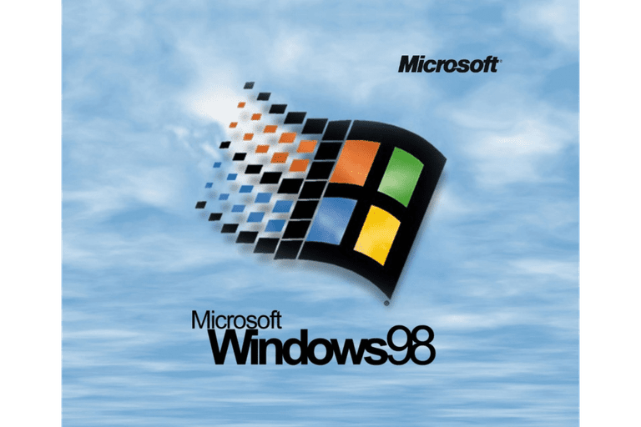
Relevance of infrastructure to data science
Usual explanation when replicating analysis:
Get this data
(Documentation) Apply this transformation to get result
No explanation of
software used
software versions
configurations
Implementation details
Digital archeology:
Suppose you are to diagnose why someone else's approach doesn't yield same results
Suppose they did their work 20 years ago.”

Slide 18
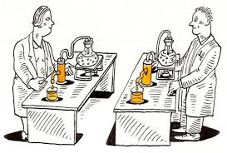
Infrastructure in data science to enable Reproducibility and Portability
In addition to data and analysis, implementation and environment matters
Use this Operating System
Install this software
Configure software this way
Add these packages
Get this data in this format
Run analysis against data
Create plots
Generate report

Slide 19
Best practices: Version control
Reproducibility applies to your own attempts (not just other people)
Regardless of how you develop analytics, you'll be creating or editing software, code and documents.
[Lesson] Regardless of how you implement best practices, avoid inventing solutions for which someone else already provided a path.
Suggested resource: https://try.github.io/

Slide 20
What ARE WE NOT COVERING?

Slide 21

Not covered: product integration
There's a complex network of dependencies (i.e. software engineers, managers) of which data science is one component.
Downstream consumers of your output are likely to be software developers who use containers and support users.
This class is focused on the data science; not with integration.
See http://dev2ops.org/2010/02/what-is-devops/

Slide 22

Not covered: security
This course is just an introduction course to prepare you for the remaining classes.
Security is not covered at all.
Notes:
https://betanews.com/2014/04/15/windows-8-1-without-update-will-no-longer-receive-security-updates/

Slide 23
SOFT SKILLS

Slide 24
DS is more than Math and Software
Human interaction in data science
Discovering stakeholders
Negotiating with data owners
Customer engagement
https://hbr.org/2017/01/the-best-data-scientists-get-out-and-talk-to-people

Slide 25
Iterating with customers
As a data scientist, you'll often be working for someone other than yourself by providing insights on data
Expect under-specified requirements from customers. Iterate.
Provide incomplete solutions rather than waiting until the product is perfect.
https://en.wikipedia.org/wiki/Minimum_viable_product

Slide 26
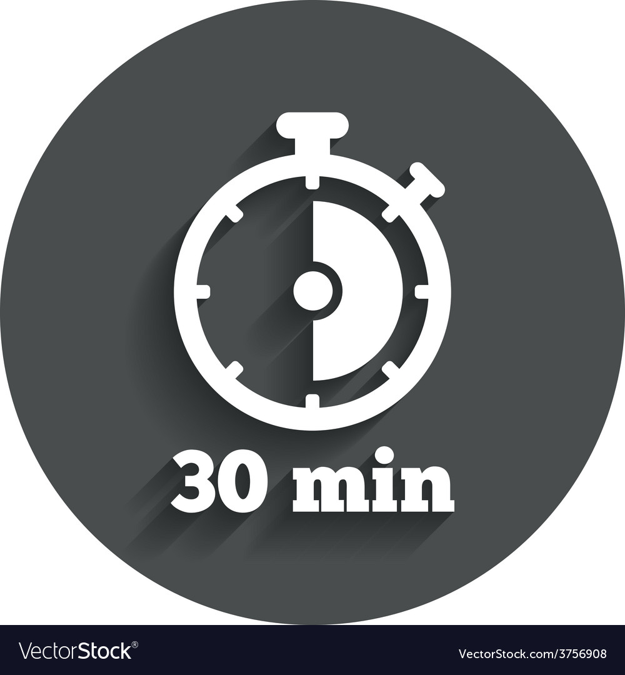
When to persist, When to change course, When to seek help
Try attacking the challenge for 30 minutes
Then seek help or do something else for a while
https://en.wikipedia.org/wiki/Pomodoro_Technique
Notes:
http://finalfantasy.wikia.com/wiki/Level_grinding
https://en.wikipedia.org/wiki/Grinding_(gaming)
https://www.vectorstock.com/royalty-free-vector/timer-sign-icon-30-minutes-stopwatch-symbol-vector-3756908

Slide 27
Pro-tip when seeking help
How to ask well-formed questions:
https://stackoverflow.com/help/how-to-ask
[Intentional sidetrack to StackOverflow]
Ask technical questions:
Poor: "I don't understand Python dictionaries" (--> online tutorials)
Better: "When is it appropriate to use a key-value pair?"
Poor: If I submitted this assignment as is, what score would I get?
Better: I am planning to submit the attached assignment, but currently there's an error in the third cell. I've searched online but don't find any references to the error message. Can you provide guidance?

Slide 28

Emotions in Data Science
As a data scientist, most of your time will be spent in a desert of uncertainty, frustration, and doubt.
There will be rare short-lived spikes of excitement and happiness due to events like getting a new dataset, creating a new analytic, getting a new result, or being thanked by a stakeholder.
This experience is normal and does not go away.
See also the psychology of slot machines
Notes:
https://www.vhtcx.com/wp-content/uploads/2015/02/canstockphoto3986275.jpg
https://www.vhtcx.com/blog/5-causes-customer-frustration-fix/

Slide 29
Reading Suggestions
50 years of data science
A Very Short History Of Data Science
Action: Read, write, tell
News and blogs
https://www.kdnuggets.com/
https://news.ycombinator.com/
https://hackernoon.com/
https://www.reddit.com/r/datascience/
https://dataelixir.com/newsletters/
https://insidebigdata.com/
https://ai.googleblog.com/
Notes:
Timeline: http://www.dataversity.net/brief-history-data-science/

Slide 30
Some Online Resources
Meetups
https://www.meetup.com/topics/data-science/
https://www.meetup.com/DataWorks/
https://www.meetup.com/Statistical-Seminars-DC/
Others
Salaries: https://www.burtchworks.com/category/salary/
A weekly social data project in R: https://github.com/rfordatascience/tidytuesday
Datasets to work with
https://datasetsearch.research.google.com/
https://datacatalog.worldbank.org/
https://opendata.maryland.gov/

Slide 31
Data Sets Online Resources
Title | Description | Link | Comment
Github | Used by many developers to share code and collaborate. | https://github.com/ | Class code is hosted in this website.
U.S. Government’s Open Data | Data, tools, and resources to conduct research, develop web and mobile applications, design data visualizations, and more. | https://data.gov/ | Real world datasets that in some cases may be extremely large.
Kaggle | Host data science competitions, datasets, Jupyter notebooks, etc. | https://www.kaggle.com/ | Good source for datasets and Jupyter Notebooks.
Google Research Data | Google Dataset Search Engine | https://datasetsearch.research.google.com/ | Search engine for datasets. May send you to data in other websites in this table.
World Bank Data | Data collections by the World Bank | https://datacatalog.worldbank.org/ | Also has collections from various sources.
Maryland Government Data | MD Open Data Website. | https://opendata.maryland.gov/ | Real world datasets from Maryland’s State Government

Slide 32
Visualization Examples and Online Resources
Title | Description | Link | Comments
MatPlotLib Example Gallery | Python Plotting Library | https://matplotlib.org/stable/gallery/index.html | Library included in Anaconda.
Seaborn Example Gallery | Python Plotting Library | https://seaborn.pydata.org/examples/index.html | Library included in Anaconda.
Plotly Example Gallery | Python Plotting Library | https://plotly.com/python/ | Library included in Anaconda.
D3.JS | Data Driven Documents Visualization Library | https://d3-graph-gallery.com/ | Used to deploy dynamic website plots.
Five Thirty Eight | Interactive Dashboard Examples | https://projects.fivethirtyeight.com/ | Excellent Website that provides great examples on the capabilities of dashboards and data analytic visualizations.
More examples of online resources in the Data 601 reference guide.

